Slide 1
Red vs. Blue
Assessment, Analysis, and Hardening of a Vulnerable System
Presentation by Reece Dillon - 2022/05/09

Slide 2
Table of Contents
This document contains the following sections:
01
Network Topology
02
Red Team: Security Assessment
03
Blue Team: Log Analysis and Attack Characterization
Hardening: Proposed Alarms and Mitigation Strategies
04

Slide 3
Network Topology
‹#›

Slide 4
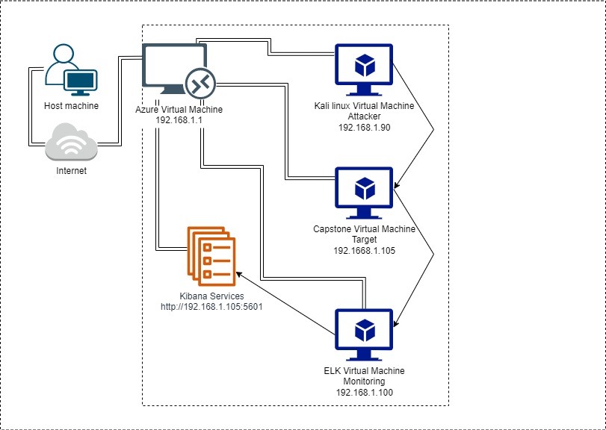
Network Topology
Network
Address Range: 192.168.1.0/24
Netmask: 255.255.255.0
Gateway: 192.168.1.1
Machines
IPv4: 192.168.1.1
OS: Windows 10 Pro
Hostname: Azure VM - Windows Gateway
IPv4: 192.168.1.90
OS: Linux
Hostname: Kali
IPv4: 192.168.1.100
OS: Linux
Hostname:ELK
IPv4: 192.168.1.105
OS: Linux
Hostname: Capstone

Slide 5

Red Team
Security Assessment
‹#›

Slide 6
Recon: Describing the Target
Nmap identified the following hosts on the network:
Hostname | IP Address | Role on Network
Azure Labs Virtual Machine - Red vs Blue | 192.168.1.1 | This is the gateway Windows VM which allows us access to the other 3 VMs hosted on Hyper-V Manager
Kali Virtual Machine | 192.188.1.90 | The Kali VM is the attacker machine used to pen-test against the vulnerable web server
Capstone Virtual Machine | 192.188.1.105 | The Capstone VM is the vulnerable apache web server being targeted running packetbeat, metricbeat and filebeat
ELK Virtual Machine | 192.188.1.100 | Network Monitoring VM to collect and process data from the attack to utilise in defence using Kibana

Slide 7
Vulnerability Assessment
The assessment uncovered the following critical vulnerabilities in the target:
Vulnerability | Description | Impact
Use the CVE number if it exists. Otherwise, use the common name. | Describe the vulnerability. | Describe what this vulnerability allows the attacker to do.
For example: LFI Vulnerability | LFI allows access into confidential files on a site. | An LFI vulnerability allows attackers to gain access to sensitive credentials

Slide 8
Exploitation: [Name of First Vulnerability]
01
02
03
Tools & Processes
How did you exploit the vulnerability? Which tool (Nmap, etc.) or techniques (XSS, etc.) did you use?
Achievements
What did the exploit achieve? For example: Did it grant you a user shell, root access, etc.?
[INSERT: screenshot or command output illustrating the exploit.]

Slide 9
Exploitation: [Name of Second Vulnerability]
01
02
03
Tools & Processes
How did you exploit the vulnerability? Which tool (Nmap, etc.) or techniques (XSS, etc.) did you use?
Achievements
What did the exploit achieve? For example: Did it grant you a user shell, root access, etc.?
[INSERT: screenshot or command output illustrating the exploit.]

Slide 10
Exploitation: [Name of Third Vulnerability]
01
02
03
Tools & Processes
How did you exploit the vulnerability? Which tool (Nmap, etc.) or techniques (XSS, etc.) did you use?
Achievements
What did the exploit achieve? For example: Did it grant you a user shell, root access, etc.?
[INSERT: screenshot or command output illustrating the exploit.]

Slide 11

Blue Team
Log Analysis and Attack Characterization
‹#›

Slide 12

Analysis: Identifying the Port Scan
Answer the following questions in bullet points under the screenshot if space allows. Otherwise, add the answers to speaker notes.
What time did the port scan occur?
How many packets were sent, and from which IP?
What indicates that this was a port scan?
[Insert Here]
Include a screenshot of Kibana logs depicting the port scan.

Slide 13
Analysis: Finding the Request for the Hidden Directory
Answer the following questions in bullet points under the screenshot if space allows. Otherwise, add the answers to speaker notes.
What time did the request occur? How many requests were made?
Which files were requested? What did they contain?
[Insert Here]
Include a screenshot of Kibana logs depicting the request for the hidden directory.

Slide 14
Analysis: Uncovering the Brute Force Attack
Answer the following questions in bullet points under the screenshot if space allows. Otherwise, add the answers to speaker notes.
How many requests were made in the attack?
How many requests had been made before the attacker discovered the password?
[Insert Here]
Include a screenshot of Kibana logs depicting the brute force attack.

Slide 15
Analysis: Finding the WebDAV Connection
Answer the following questions in bullet points under the screenshot if space allows. Otherwise, add the answers to speaker notes.
How many requests were made to this directory?
Which files were requested?
[Insert Here]
Add a screenshot of Kibana logs depicting the WebDAV connection.

Slide 16
Blue Team
Proposed Alarms and Mitigation Strategies
‹#›

Slide 17
Mitigation: Blocking the Port Scan
What kind of alarm can be set to detect future port scans?
What threshold would you set to activate this alarm?
What configurations can be set on the host to mitigate port scans?
Describe the solution. If possible, provide required command lines.

Slide 18
Mitigation: Finding the Request for the Hidden Directory
What kind of alarm can be set to detect future unauthorized access?
What threshold would you set to activate this alarm?
What configuration can be set on the host to block unwanted access?
Describe the solution. If possible, provide required command lines.

Slide 19
Mitigation: Preventing Brute Force Attacks
What kind of alarm can be set to detect future brute force attacks?
What threshold would you set to activate this alarm?
What configuration can be set on the host to block brute force attacks?
Describe the solution. If possible, provide the required command line(s).

Slide 20
Mitigation: Detecting the WebDAV Connection
What kind of alarm can be set to detect future access to this directory?
What threshold would you set to activate this alarm?
What configuration can be set on the host to control access?
Describe the solution. If possible, provide the required command line(s).

Slide 21
Mitigation: Identifying Reverse Shell Uploads
What kind of alarm can be set to detect future file uploads?
What threshold would you set to activate this alarm?
What configuration can be set on the host to block file uploads?
Describe the solution. If possible, provide the required command line.

